Slide 1

LOAN STATUS PREDICTION USING MACHINE LEARNING
Presented by SRIKANTA PRASAD G
Intern ID MST03-0032
Guided by UROOJ KHAN
Submitting to SCIFOR TECHNOLOGY

Slide 2
WHAT IS LOAN STATUS PREDICTION:
It is a classification problem, given data or information about the application that we have to predict and they give result if loan is eligible or not.
Lenders can improve accuracy from the user data and reduce the risk, and improves portfolio quality.
Machine learning models for credit scoring take into account the actual risk an individual poses when taking credit and allows lending providers to offer risk-based rates. I.e., High rates for high-risk borrowers, lower rates for low-risk borrowers

Slide 3
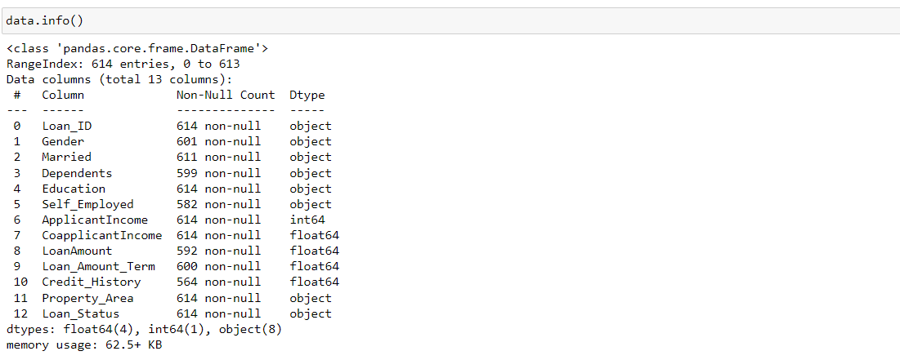
GETTING INFORMATION ABOUT THE DATASET :

Slide 4
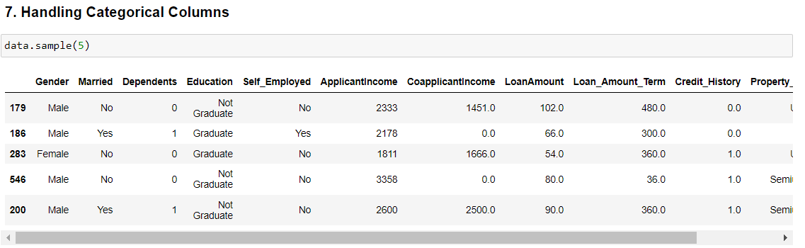
PREPARATION OF DATA AND CATEGORIZING IT :

Slide 5
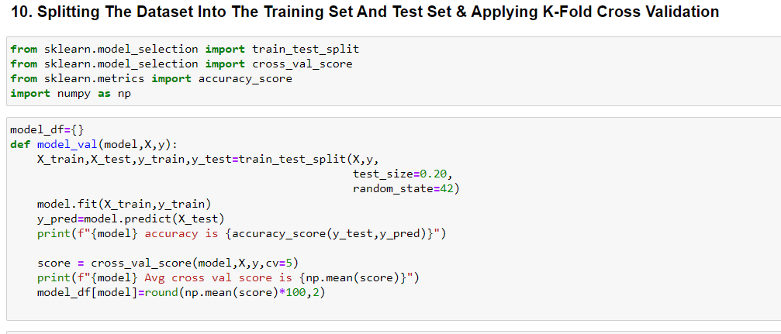
SPLITING DATASETS FOR TRAIN AND TEST

Slide 6
GRAPHIC USER INTERFACE
This model uses tkinter which is standard python interface to the GUI toolkit.
The concept of graphical user interface machine learning framework. CSV dataset files with a labeled variable were dragged and dropped onto a dashboard. Using this we can predict the approval of loan can be identified.
In this model, using some personal information like gender, married status, education, loan amount, credit history and some more. Using these information, according to the loan approval model limit can be seen that individual loan status is positive or negative.

Slide 7
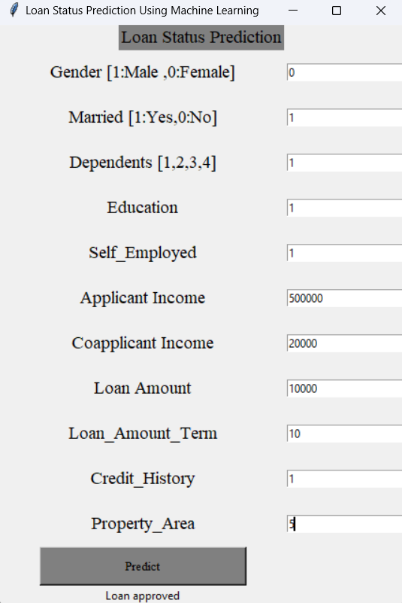
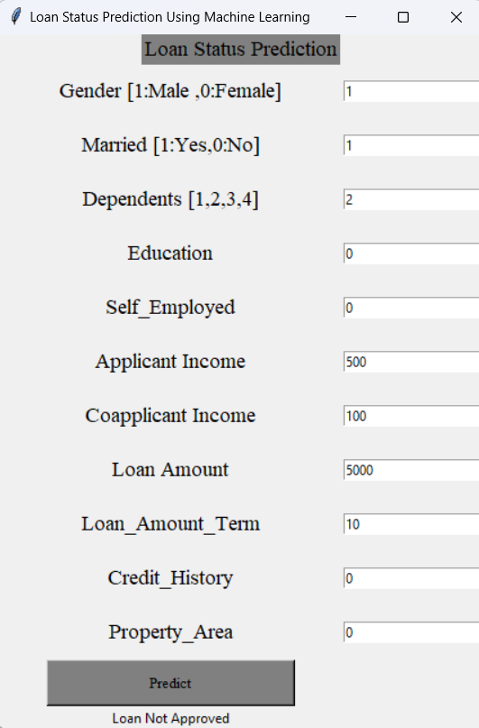
WORKING OF GUI:
This model shows the status of loan approval according to the loan amount, credit history and income.

Slide 8
CONCLUSION :
This work's primary objective is to predict whether the loan approval to a specific individual is safe or not.
The aim of this is quick, immediate and easy way to choose the better loan applicants.
Lenders can improve accuracy from the user data and reduce the risk, and improves portfolio quality.

Slide 9
THANK YOU

